Slide 1
Display Ideas for EVA suit
Goals:
#1:expand FOV
-increase safety
-increase comfort
-increase maneuverability
All of the following displays would be fed by an external camera, either a new one(with larger FOV or a currently used camera)

Slide 2
Glossary:
HUD: heads up display
OSD: on screen display
HMD: Head mounted display
EVA: Extravehicular activity
Comms: communications
VR: virtual reality

Slide 3
HUD
Idea 1 (John inspired)

Slide 4

small micro display prism located in FOV
-can be located top left or right corner, or bottom left or right corner.

Slide 5
“VR” Goggles
Idea 2 (Josh inspired)

Slide 6
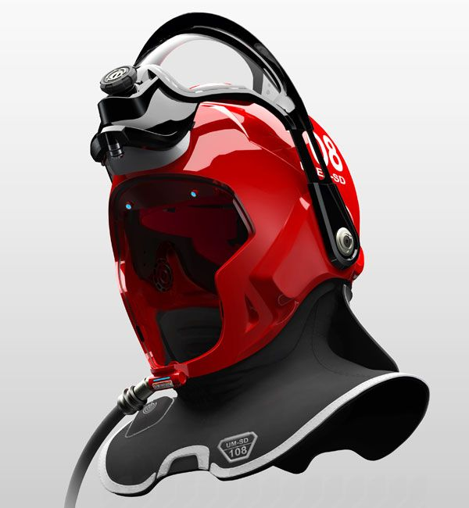
Goggles Integrated with helmet
-Goggles would display feed from 180 degree camera.
-minimizing size of glass bubble, and allowing for greater maneuverability.

Slide 7
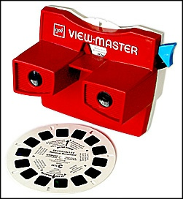
Goggles Integrated with helmet cont.
-Could be used as lense system meaning that it can be dis-engaged

Slide 8
HUD OSD
Idea 3

Slide 9
Projection directly on to glass bubble
-project certain frequency/light that will only be seen if looked through certain lense or film
-projector always runs giving camera feed
-flim/visor would be retractable for when you don’t want/need the feed.

